Slide 1

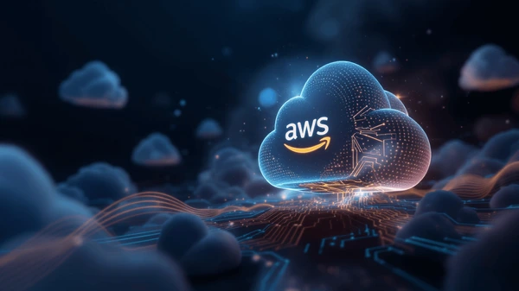
AWS AI FOR BHARAT HACKATHON
Bharat Access Hub
Team Name :
AI-Powered Government Scheme Discovery Platform
Team Leader Name :
Problem Statement :
Conversational AI
Intelligent Matching
10 Languages
Team Name :RUGVED SYSTEMS
Team Leader Name :DEBDYUTI SARKAR
Problem Statement :Build an AI-powered solution that improves access to information, resources, or opportunities for communities and public systems.

Slide 2

The Challenge
Critical barriers preventing citizens from accessing government benefits
Low Awareness
High Drop-off
30-40%
70%
of eligible beneficiaries are aware of schemes they qualify for
application abandonment rate due to complexity and confusion
Language Barriers
Fragmentation
22
100+
official languages with limited digital support for regional languages
government portals with scattered information and no unified access
₹50,000+ Crores in scheme budgets remain unclaimed annually

Slide 3

Our Solution: Bharat Access Hub
AI-powered platform bridging the information access gap
Conversational AI Interface
Natural language chatbot powered by RAG (Retrieval Augmented Generation) that understands context, answers questions, and guides users through complex scheme information in their preferred language.
Platform Impact
10,000+
Concurrent Users
<3 sec
Intelligent Eligibility Matching
Response Time
AI-driven scoring algorithm that analyzes user profiles against scheme criteria, providing personalized eligibility scores (0-100) and ranking opportunities by relevance and benefit value.
95%
Matching Accuracy
10
Indian Languages
Document Intelligence
OCR-powered form processing with Amazon Textract that extracts text, explains fields in simple language, auto-fills from user profiles, and validates submissions before sending to government portals.
Security First
End-to-end encryption with AWS KMS, DPDPA 2023 compliant, RBAC access control, and comprehensive audit logging.

Slide 4
What Makes Us Different
Unique capabilities that set Bharat Access Hub apart
RAG-Powered Multilingual Chatbot
AI-Driven Eligibility Scoring
Intelligent Document Processing
Unlike simple FAQ bots, our RAG system retrieves real-time scheme data and generates contextual responses in 10 Indian languages using Claude 3 Sonnet.
Proprietary algorithm computes 0-100 eligibility scores by matching user profiles against scheme criteria with weighted factors for demographics, income, location, and more.
Amazon Textract OCR extracts form fields, explains them in simple language, auto-fills from user profiles with 90%+ accuracy, and validates before submission.
Context-aware conversations
Personalized recommendations
Reduces form completion time by 70%
Voice Interface for All
Unified Portal Integration
Enterprise-Grade Security
Amazon Transcribe and Polly enable voice-based interactions for low-literacy users, supporting 10 languages with adjustable speech rates for better comprehension.
Seamless integration with 100+ government portals, providing direct application links with pre-filled data and tracking application status across multiple systems.
End-to-end encryption with AWS KMS, DPDPA 2023 compliance, RBAC access control, comprehensive audit logging, and user data export/deletion rights.
Accessibility-first design
One platform, all schemes
Privacy by design

Slide 5
Key Features
Six core capabilities powering the platform
Smart Profile Builder
AI Chatbot with RAG
Eligibility Engine
Progressive questionnaire capturing demographics, location, education, employment, income, and family details with real-time completion tracking.
Conversational AI powered by Amazon Bedrock Claude 3 Sonnet with RAG pipeline for accurate, contextual responses about schemes and processes.
AI-driven scoring algorithm matching user profiles against scheme criteria with 0-100 scores, ranking by eligibility × benefit × urgency.
Progressive
Auto-save
10 Languages
RAG
0-100 Score
Real-time
Document Intelligence
Personalized Dashboard
Voice Interface
Amazon Textract OCR extracts text from forms, explains fields in simple language, auto-fills from profiles, and validates submissions.
Curated scheme recommendations ranked by relevance, AI-generated insights, urgent deadline alerts, and application status tracking.
Amazon Transcribe and Polly enable voice-based interactions for low-literacy users with adjustable speech rates in 10 languages.
OCR
Auto-fill
AI Insights
Tracking
Speech-to-Text
Text-to-Speech

Slide 6
User Journey Flow
End-to-end experience from registration to application
Registration
Profile
Discovery
Eligibility
Documents
Apply
Track
Cognito Auth
DynamoDB
AI Chatbot
Scoring
OCR + Fill
Portal Link
Status
Time to First Scheme
Application Success Rate
Continuous Updates
Users see personalized recommendations within 5 seconds of profile completion
Document assistance and validation improve completion rates from 30% to 85%
Eligibility scores auto-recalculate when profile changes or new schemes launch

Slide 7
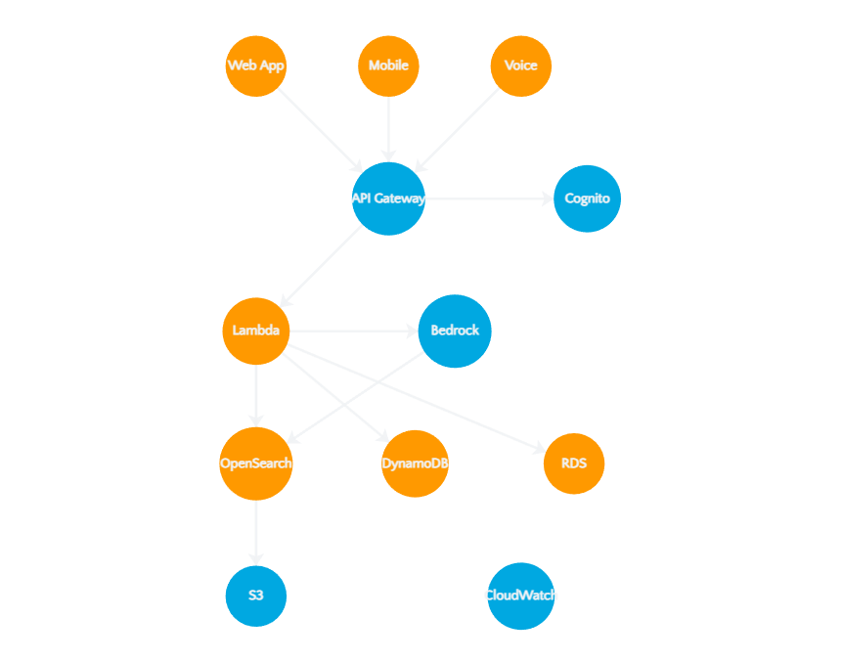
System Architecture
Client Layer
React Web App, React Native Mobile, Voice Interface via CloudFront CDN
API & Security
API Gateway (REST + WebSocket), AWS Cognito Auth, RBAC, WAF protection
Lambda Services
Profile, Eligibility, Chat, Document, Search, Notification microservices
AI/ML Services
Bedrock (Claude 3, Titan), Textract, Comprehend, Transcribe, Polly, Translate
Data Layer
OpenSearch (Vector DB), DynamoDB, RDS PostgreSQL, S3, ElastiCache Redis

Slide 8

RAG Pipeline - The AI Brain
RAG Data Flow
Document Chunking
Chunk Size:
512 tokens
Overlap:
50 tokens
Boundary:
Sentence
Titan Embeddings
Document
Chunking
Embeddings
OpenSearch
Dimensions:
1536
PDF/URL
512 tokens
1536-dim
Vector DB
Max Input:
8192 tokens
Cost:
$0.10/M tokens
User Query
Semantic
Claude 3
Response
Claude 3 Sonnet
Any Language
Top 5 Chunks
Generate
Personalized
Context:
200K tokens
Input Cost:
$3/M tokens
Output Cost:
$15/M tokens
<3s
95%
10
40%+
Response Time
Accuracy
Languages
Cache Hit

Slide 9
AWS Technology Stack
AI / ML
Compute & API
Data & Storage
Amazon Bedrock
AWS Lambda
Amazon OpenSearch
Claude 3 Sonnet LLM, Titan Embeddings
Serverless microservices, Python/Node.js
Vector DB, semantic search, 1536-dim
Amazon Textract
API Gateway
Amazon DynamoDB
OCR, form field extraction
REST + WebSocket APIs
NoSQL, users, chat history, applications
Amazon Comprehend
Amazon Cognito
Amazon RDS
NLP, language detection
User auth, MFA, JWT tokens
PostgreSQL, scheme metadata
Transcribe & Polly
AWS WAF
Amazon S3
Speech-to-text, text-to-speech
DDoS protection, rate limiting
Document storage, static assets
Amazon Translate
CloudFront
ElastiCache
Real-time translation, 10 languages
Global CDN, edge caching
Redis caching, session store
CloudWatch
- Monitoring & Logging
AWS KMS
- Encryption
X-Ray
- Distributed Tracing

Slide 10
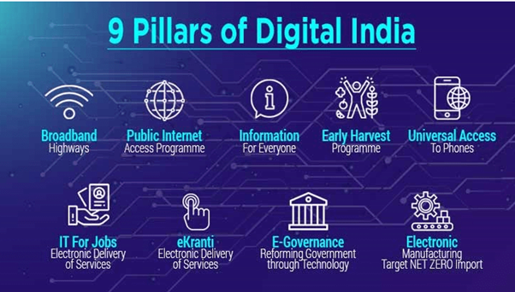
Impact & Metrics
Projected performance and societal impact
Concurrent Users
Response Time
Societal Impact
10,000+
<3 sec
₹50,000+ Crores
Unclaimed benefits accessed annually
Serverless auto-scaling handles traffic spikes seamlessly
95% of chatbot queries answered within 3 seconds
Millions of Citizens
Empowered with scheme awareness
3x Improvement
In application completion rates
Matching Accuracy
Translation Savings
95%
70%
System Reliability
Eligibility scoring accuracy with AI-driven criteria evaluation
Cost reduction through DynamoDB translation caching
Uptime SLA
99.9%
Cache Hit Rate
>40%
Auto-scaling
Instant

Slide 11
Implementation Roadmap
1
Phase 1: MVP
2
Phase 2: Scale
3
Phase 3: Optimize
Months 1-3
Months 4-6
Months 7-12
Core Chatbot
Document Intelligence
Portal Integrations
RAG pipeline with Claude 3, 5 languages
Textract OCR, auto-fill, validation
50+ government portal APIs
Basic Profile Builder
Voice Interface
Advanced Analytics
Progressive questionnaire, DynamoDB storage
Transcribe + Polly, 10 languages
User behavior, scheme performance
Eligibility Engine
Advanced Search
AI Improvements
Scoring algorithm, 100 top schemes
Semantic + keyword hybrid, filters
Fine-tuned models, feedback loop
Dashboard
Mobile App
Multi-State Launch
Personalized recommendations, basic UI
React Native, offline mode
Pan-India rollout, regional partners
Target Users:
1,000 beta
Target Users:
10,000
Target Users:
100,000+

Slide 12
Why AWS?
Comprehensive AI/ML Stack
Serverless Scalability
Amazon Bedrock provides unified access to Claude 3 Sonnet and Titan Embeddings, eliminating the need for multiple AI providers. Textract, Comprehend, Transcribe, Polly, and Translate complete the AI ecosystem.
AWS Lambda auto-scales from 0 to 10,000+ concurrent users instantly. API Gateway handles millions of requests with built-in throttling and caching. Pay only for what you use.
Enterprise Security
Multi-Region Availability
AWS KMS provides encryption at rest, Cognito handles authentication with MFA support, WAF protects against attacks, and comprehensive audit logging ensures DPDPA 2023 compliance.
Deploy across Mumbai, Hyderabad, and other regions for low-latency access. CloudFront CDN delivers content from 450+ edge locations. 99.9% uptime SLA with multi-AZ redundancy.
Cost-Effective Model
200+ Services Ecosystem
Pay-per-use pricing aligns costs with actual usage. Reserved capacity for predictable workloads. Free tier for development and testing. Estimated monthly cost: ₹2-3 lakhs for 10K users.
Seamless integration between services. OpenSearch for vector search, DynamoDB for NoSQL, RDS for relational data, S3 for storage, and 195+ more services for future expansion.

Slide 13

Empowering Bharat
Through AI
Bharat Access Hub bridges the gap between citizens and government services,
one conversation at a time.
10
100+
₹50K Cr+
Indian Languages
Portal Integrations
Benefits Unlocked
Powered by AWS
Built for Bharat

Slide 14


